Slide 1


Azure Cache for Redis
November, 2018

Slide 2

Agenda
What is caching? Different models of caching
What is Azure Cache for Redis?
Key benefits and pricing
Q&A

Slide 3
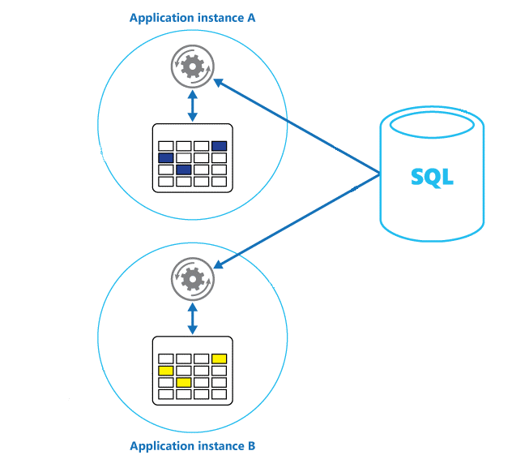
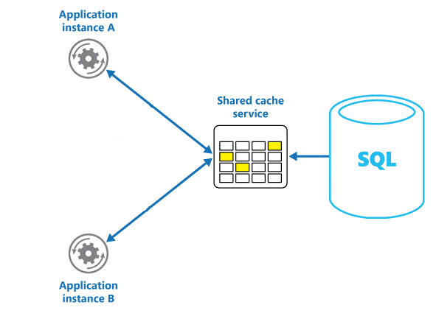
What is caching?
Caching is a technique to improve the performance and scalability of a system.
Types of caching:
Private or Local cache
Cache is an in-memory store, which is running in the same process as Application
Shared or Distributed cache
Cache is located on separate host and provides an access to different application instances

Slide 4

Azure cache for Redis
Azure Redis Cache is the Microsoft Azure service based on popular open source Redis Cache
Azure Redis Cache is an in-memory database
Azure Redis Cache provides access to Redis servers that are hosted at an Azure datacenter
Redis is a key-value store, where values can contain simple types or complex data structures such as hashes, lists, and sets.

Slide 5
Key benefits and pricing
Different Pricing Models:
Basic
Ideal for development and testing
Standard
Production ready cache with master/slave replication
Premium
Enterprise ready tier which can be used as a cache and persist data.
Data persistence
Cluster support
Geo replication
High Performance
Supports a variety of programming languages
.Net, .Net Core, Java, Node.js, Python
Leverages Redis authentication and supports SSL for securing cache/client communication
Makes Redis cache highly available by having primary and secondary replica cache
Monitoring the health and performance of the cache

Slide 6
General patterns of usage
Cache-Aside - to load data items into the cache only as needed
Content Caching - will give your web servers quick access to static content of web pages or rare updated heavy load pages compared to backend datastores
User session caching – to keep extended data about user session in cache instead of cookies
Job and message queuing – to use cache as message queue to leverage heavy load DB requests
Distributed transactions

Slide 7
Notes:
Pricing calculator

Slide 8

Q&A
Saratov Azure Community:
Dmitriy Blokhin
Emails:
OrgAzureCommunitySaratov@epam.com
Dmitriy_Blokhin@epam.com

